Slide 1

Friday

Slide 2

Objectives:
Scenarios with observational assessment
Scenario Feedback
Questionnaire
Questionnaire Feedback
Summary
Question time

Slide 3
Scenario 1
Meet Bella Mannequin. She is a 53 year old lady who was admitted to Holy Cross hospital 2 years ago. She has an acquired brain injury following an assault. She has a uncuffed tracheostomy in. She requires enteral feeding, but can have tasters for enjoyment. She has a urethral catheter in situ. She is a very private woman who can get upset easily.
Please provide morning care for Bella. Please get her washed, dressed and up in her chair for the day, applying all the knowledge you have gained in class over the last 3 days.
The more you role play, the more you'll get out of this!
Donna and Helen will be observing and assessing all aspects of care provided

Slide 4
Scenario 2
Bella Mannequin is a 53 year old woman who fell from her horse 10 years ago, sustaining a spinal cord injury . She has an uncuffed tracheostomy in and is ventilated 24/7. She can get very anxious about falling. Bella is able to eat and drink orally most of the time and has a gastrostomy tube in place for the administration of medications. She has a suprapubic catheter in situ.
Please provide morning care for Bella. Please get her washed, dressed and up in her chair for the day, applying all the knowledge you have gained in class over the last 3 days.
The more you role play, the more you'll get out of this!
Donna and Helen will be observing and assessing all aspects of care provided

Slide 5


Slide 6
Scenario 3
Bella is a 53 year old Gentleman who suffered an out of hospital cardiac arrest 4 years ago, He suffered an acquired brain injury. Bella has an uncuffed tracheostomy in situ, he is enteral fed via a gastrostomy tube and has a convene in situ. Bella likes to hold on to what little independence he has left .
Please provide morning care for Bella. Please get her washed, dressed and up in her chair for the day, applying all the knowledge you have gained in class over the last 3 days.
The more you role play, the more you'll get out of this!
Donna and Helen will be observing and assessing all aspects of care provided

Slide 7
Scenario 4
Bella is a 53 year old woman who has locked in syndrome following an enquired brain injury 17 years ago. She has a cuffed tracheostomy in situ. Bella is entirely dependant on care staff. Bella is enteral fed, and has a suprapubic catheter in situ.
Please provide morning care for Bella. Please get her washed, dressed and up in her chair for the day, applying all the knowledge you have gained in class over the last 3 days.
The more you role play, the more you'll get out of this!
Donna and Helen will be observing and assessing all aspects of care provided

Slide 8

1 to 1 Feedback on scenarios and observational assessment

Slide 9
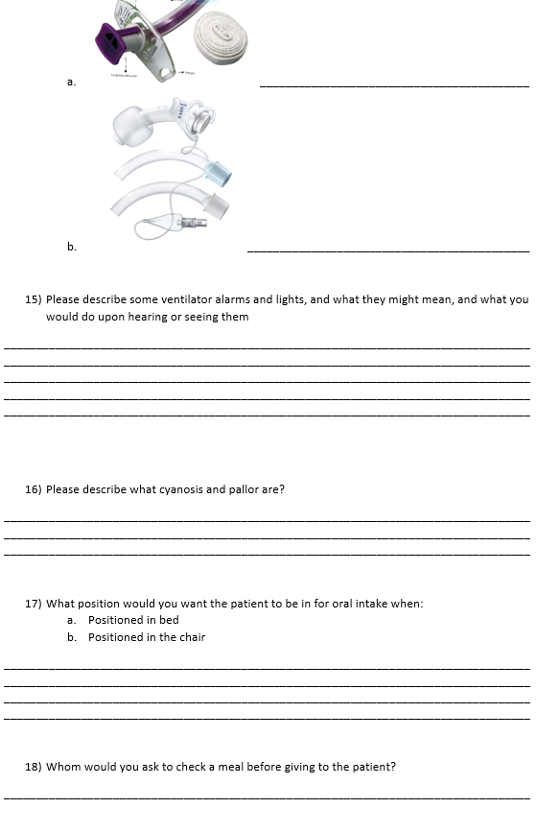
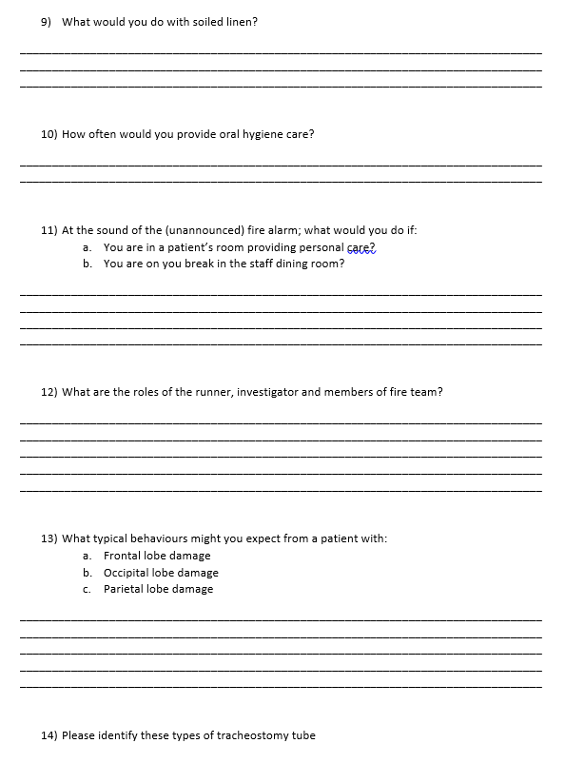

Questionnaire
You'll now be given a questionnaire of 22 questions to see how much you’ve learnt and retained which has not been covered in the observational assessment
Please try to answer and complete all questions provided

Slide 10


Slide 11

Please use the next hour to do some eLearning

Slide 12

1 to 1 feedback on questionnaires

Slide 13


Summary of topics covered in the classroom this week:
Do you have any questions on these topics?
Is there anything you would like to revisit?
Orientation and fire safety
Safe moving and handling
Acquired brain injury
Infection prevention and control
The respiratory system
Nutrition and the digestive system
The elimination system
Basic patient care
Documentation
Vital signs monitoring

Slide 14

Elearning topics you’ve hopefully completed this week:
Do you have questions on these topics?
Is there anything you would like to discuss in person?
Information governance
Health and safety
Clinical governance
Safeguarding
Equality, diversity and human rights
Complaints, compliments and conflict management
Whistleblowing
History of Holy Cross

Slide 15
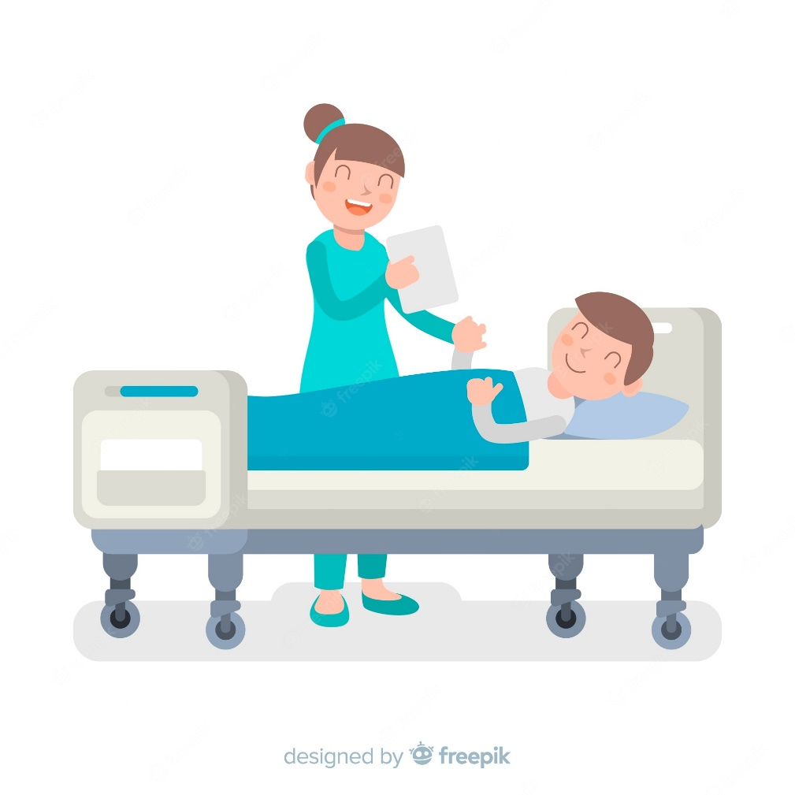
Next week
Monday – Friday 9am – 5pm on the ward
  With your assigned mentors
Thursday 4pm
  Joanna, Donna and Helen will be having a catch up with you
How are you feeling about going onto the wards?

Slide 16

Please use any remaining time today to continue with your eLearning

Slide 17


